Slide 1


A Tkinter-based Framework For Covid-19 Disease Prediction
Presented By
Dibyaranjan Das
B.Tech (Cse)
2321322053
GUIDED BY PYTHONSOFT LLP

Slide 2

INTRODUCTION -:
The Covid-19 Pandemic Has Posed Unprecedentented Challenges To Global Healthcare Systems, Emphasizing The Need For Accurate And Timely Disease Prediction. This Project Aims To Devloped a User-friendly Tkinter-based Gui That Leverages Machine Learning Algorithim To Predict Covid-19 Disease .
OBJECTIVE -:
Design And Implement A Tkinter-based Covid-19 Disease Prediction System Utilizing Machine Learning Algorithim To :
Analyse Patient Data
Predict Covid-19 Diagnosis
Provide Insights For Healthcare Proffessional

Slide 3
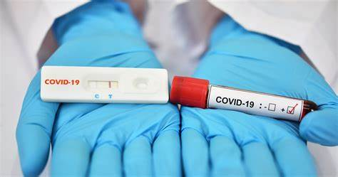
Abstract -:
This project presents a Tkinter-based GUI that utilizes machine learning algorithms to predict COVID-19 disease diagnosis. Leveraging a dataset of patient characteristics and medical history, the system employs logistic regression, decision trees, knn model,naïve bayes model to forecast COVID-19 positivity. The GUI enables users to input patient data and visualize prediction results. Evaluation metrics demonstrate the model's accuracy, precision, and recall. This project contributes to the development of accessible and accurate disease prediction tools, supporting healthcare professionals in early detection and prevention of COVID-19.

Slide 4
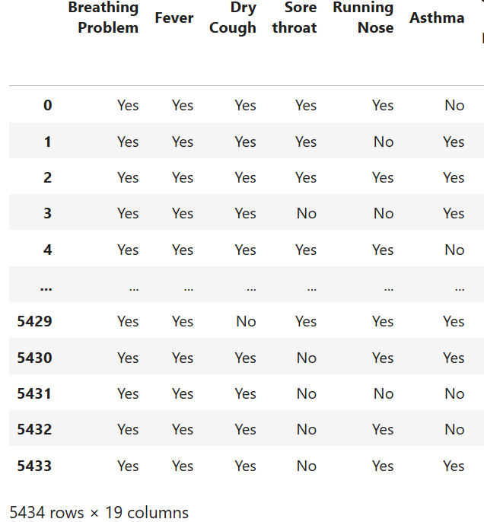

DATA description -:
The dataset used for this project consist of (18) records of patient data , collected from [world health data ] , data source-: www.pythonsoft.org. the data set includes the following feature:BreathingProblem,Fever,DryCough,Sorethroat,RunningNose,Asthma,ChronicLungDisease,Headache,HeartDisease,Diabetes,HyperTension,Abroadtravel,ContactwithCOVIDPatient,AttendedLargeGathering,VisitedPublicExposedPlaces,FamilyworkinginPublicExposedPlaces,WearingMasks,SanitizationfromMarket.

Slide 5
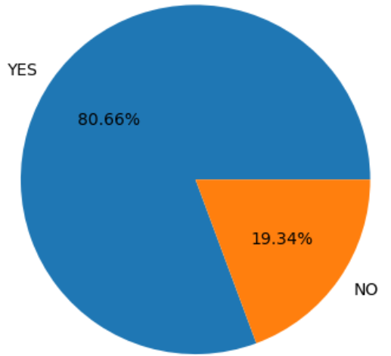
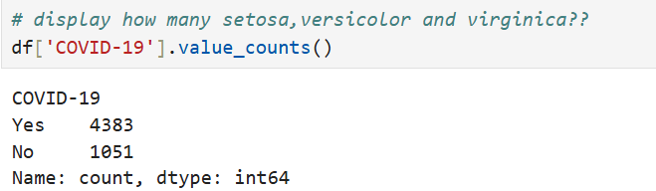
Data visualization -:
Matplotlib Visualization-:
Here The Covid-19 Result Shown Piechart In Matplotlib As Percentage And Different ,Color,value(),labels,autopct Use.

Slide 6
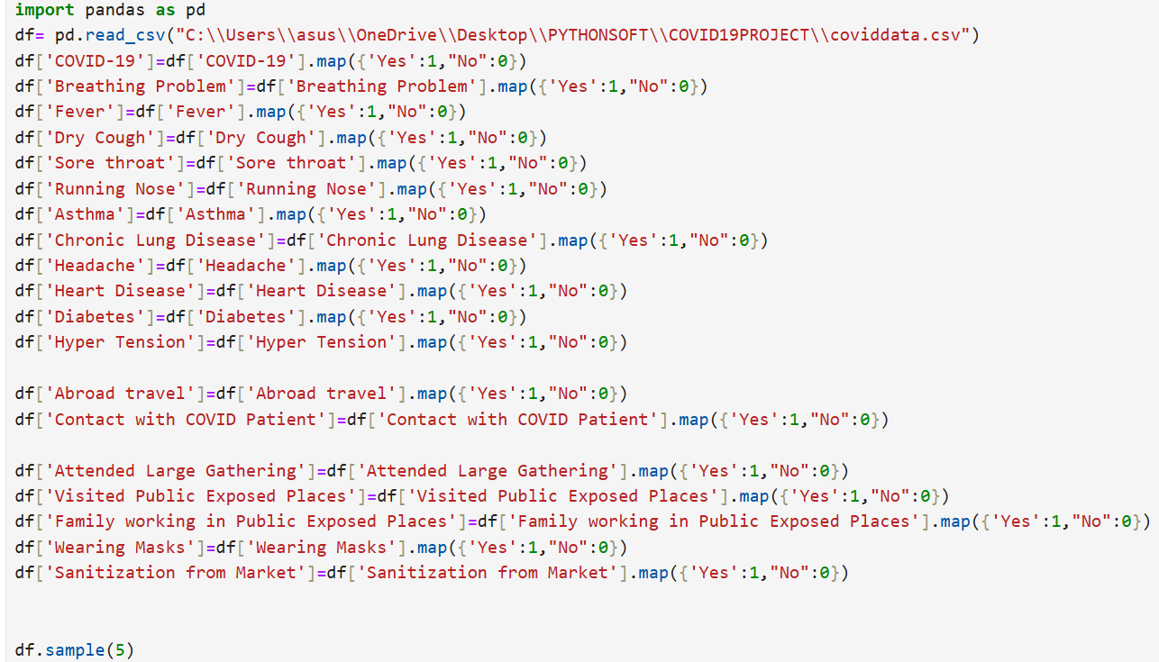
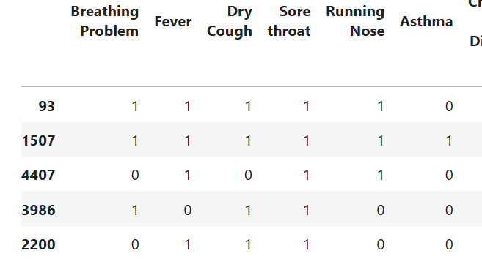
DATA PROCESSING -:
Here The All Value Has Been Converted To Numeric Using Map Function In Pandas,and Showing The Five Sample.

Slide 7
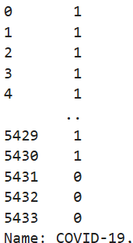
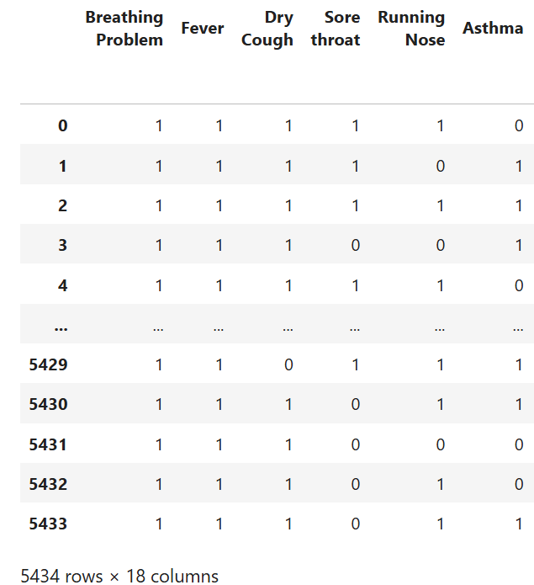
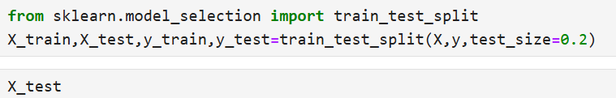
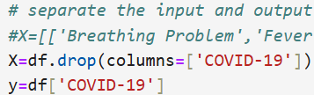
Workflow diagram -:
*Separating The All Input And Output Data To Trainning And Testing Purpose.
*Here Spilt The Data Set For Trainning And Testing Using Sklearn Model. *The Dataframe Gets Divided Into X_train,x_test , Y_train And Y_test. X_train And Y_train Sets Are Used For Training And Fitting The Model. The X_test And Y_test Sets Are Used For Testing The Model If It’s Predicting The Right Outputs/Labels

Slide 8
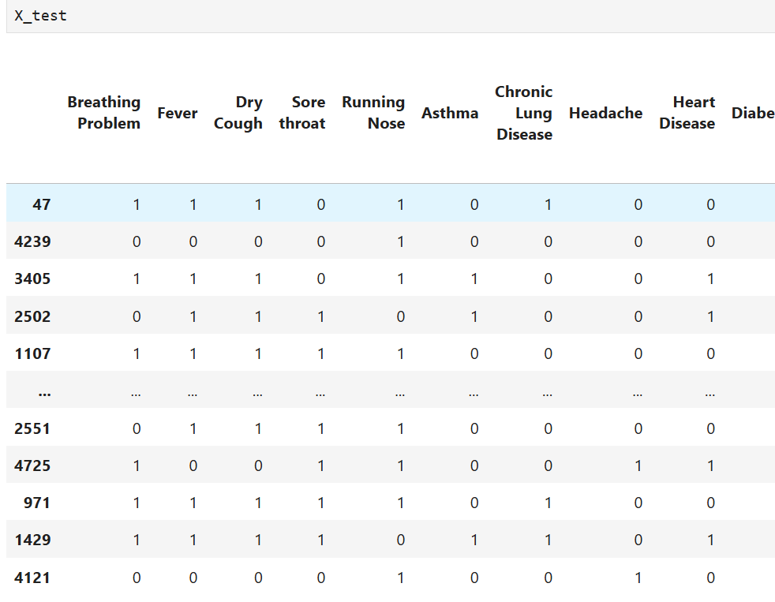
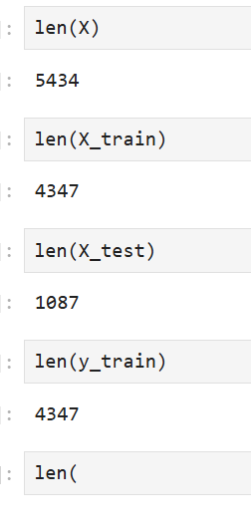
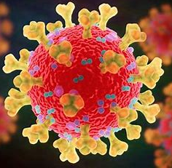
WORKFLOW DIAGRAM -:

Slide 9
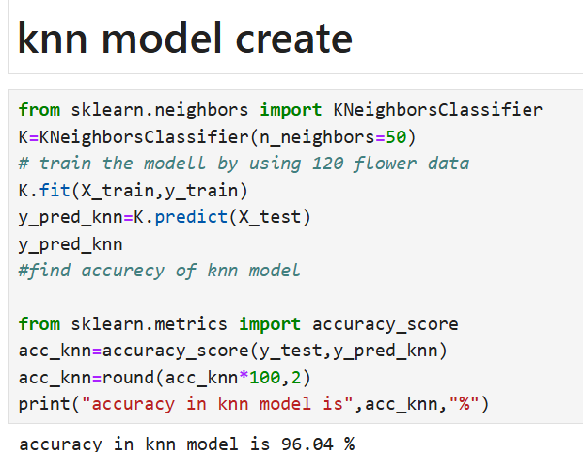

Model creation --:
Creating The KNN Model
Calculate distance between new patient data and existing dataset.
Select K nearest neighbors based on distance.
Assign weight to each neighbor based on proximity.
Predict COVID-19 diagnosis using weighted voting.

Slide 10
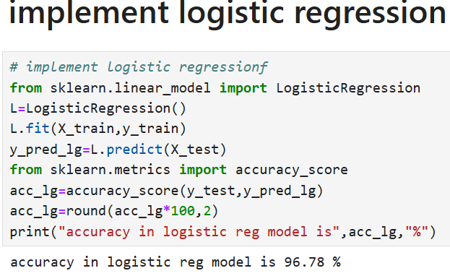

Model creation --:
Creating The Logistic Regression Model
Model the probability of COVID-19 diagnosis using a logistic function.
Learn model coefficients from training data.
Predict COVID-19 diagnosis based on probability threshold.
Logistic Regression is a popular choice for binary classification problems like COVID-19 disease prediction. However, it assumes linear relationships between features and may not perform well with non-linear relationships.

Slide 11
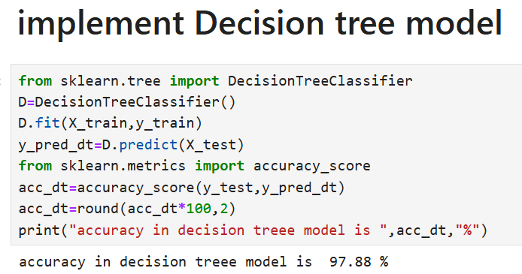
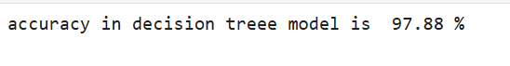
Model creation --:
Creating The Decision Tree Model
A decision tree is a graphical representation of a decision-making process. It's a tree-like model that breaks down a complex decision into smaller, more manageable subsets. The model works by recursively partitioning the data into smaller subsets based on the most informative features.
The predicted class label or target value is determined by traversing the tree from the root to a leaf node.

Slide 12
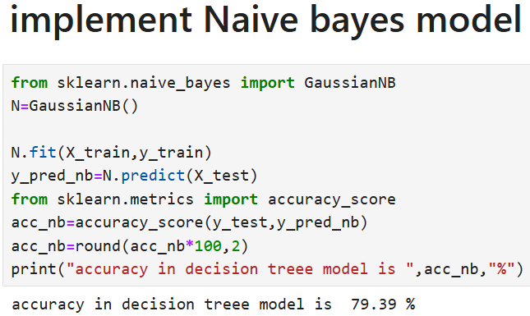

Model creation --:
Creating The Naïve Bayes Model
Naive Bayes is a popular, probabilistic machine learning algorithm for classification tasks. It's based on Bayes' theorem and assumes independence between features.
Training: Calculate prior probabilities and likelihoods from training data.
Prediction: Calculate posterior probabilities for new data using Bayes' theorem.

Slide 13
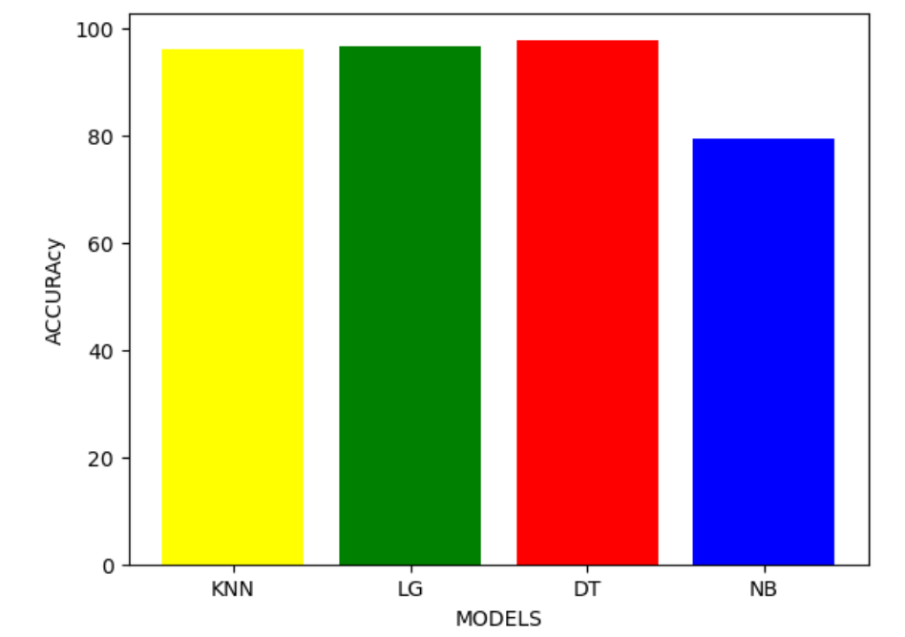
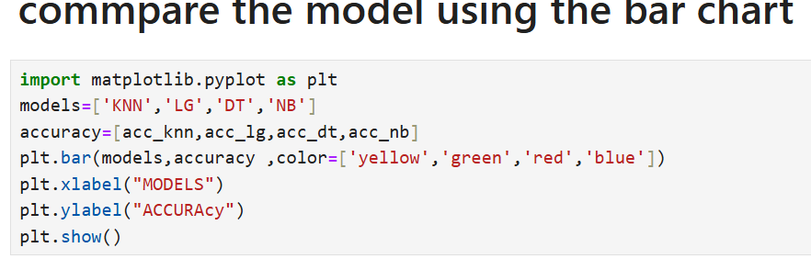
Performance evaluation -:
* Its accuracy is shown in a bar chart comparing all model.

Slide 14
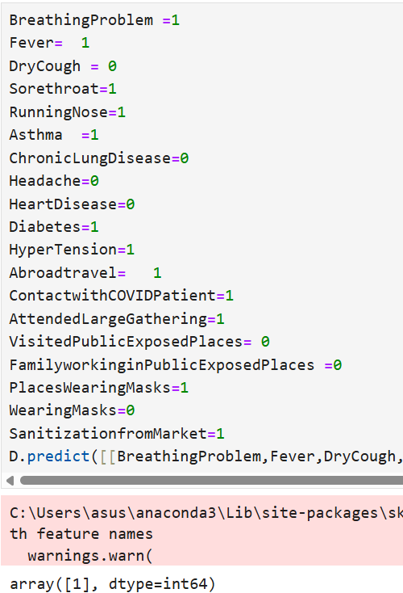
Performance evaluation --:
Predicted the covid result using some symptons.
Here result ,
1 means = Covid Positive
0 means = Covid Negative

Slide 15


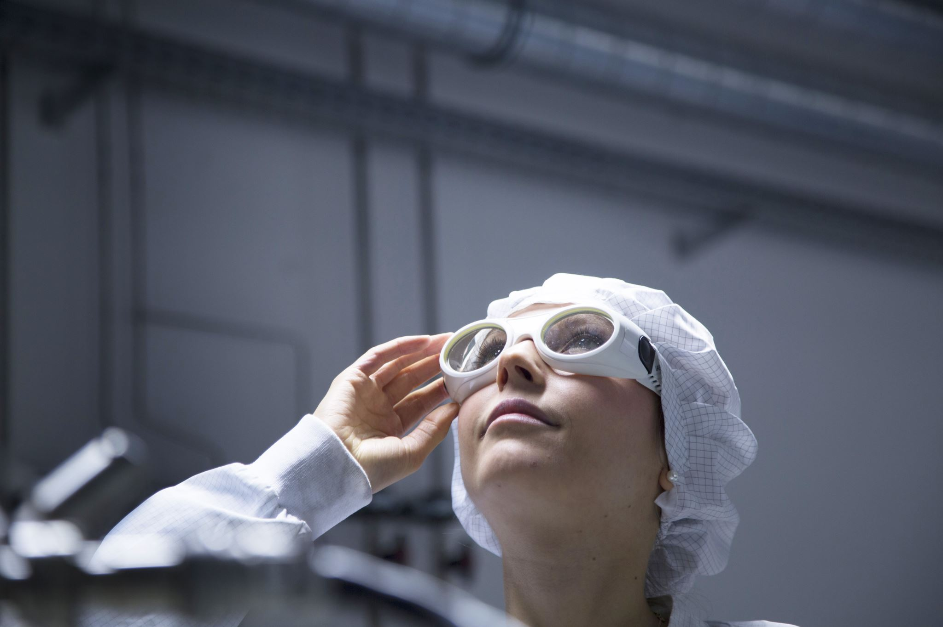
Devlop the GUI using tkinter

Slide 16
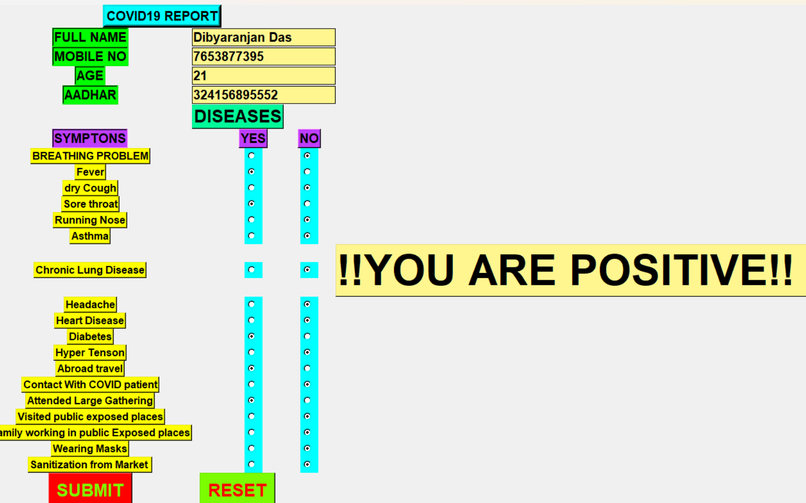











Implementation using gui --:
GUI COMPONETS --:
• Labels for feature input ( All Symptons).
• Entry widgets for user inputs.
• SUBMIT Button for prediction and Reset button for reset all data
. • Label to display the prediction result.

Slide 17
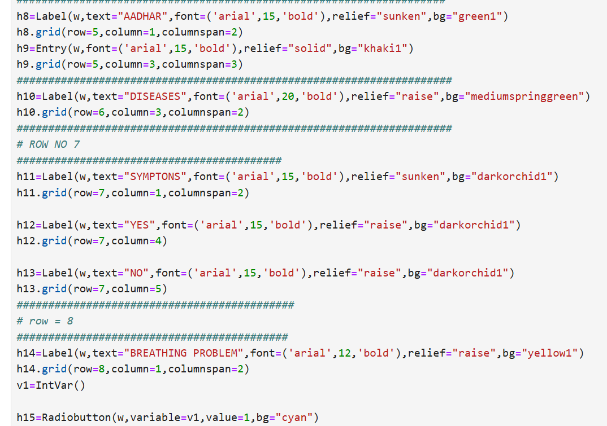
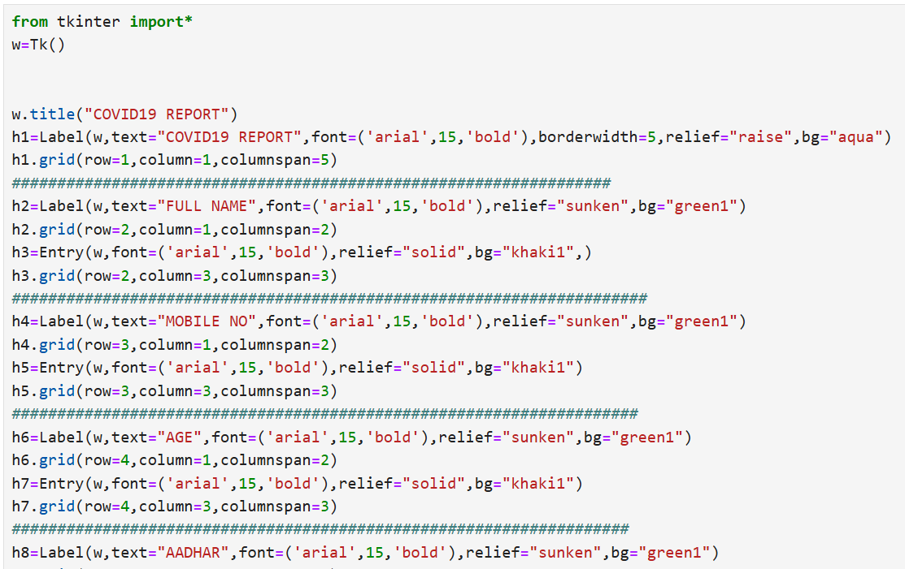
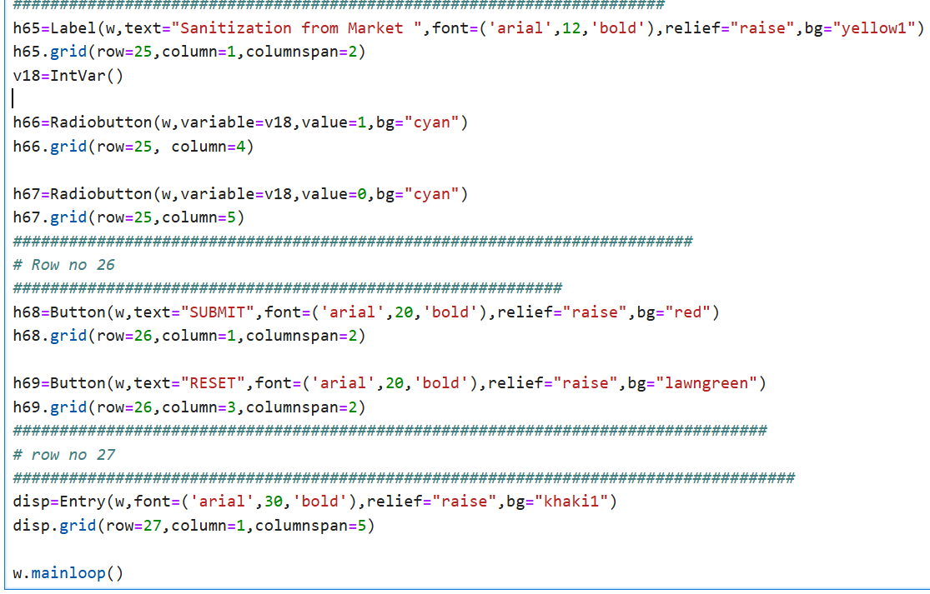
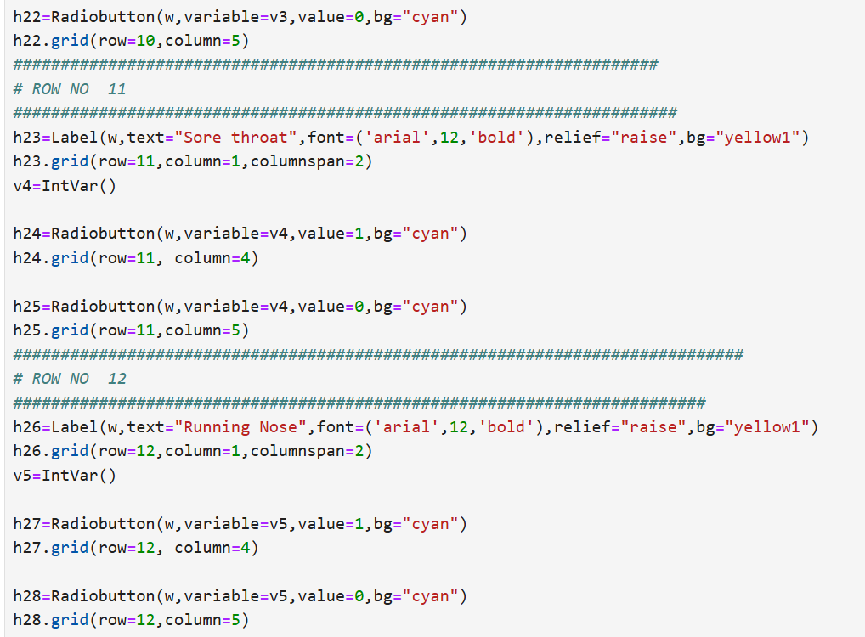
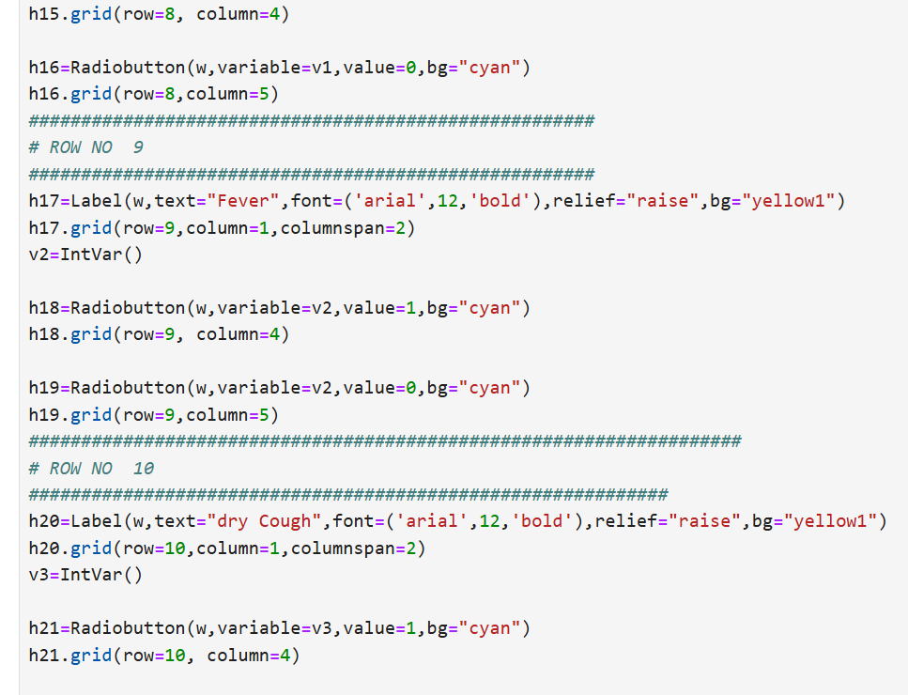
CODE WORKTHROUGH --:

Slide 18

Conclusion --:
SUMMARY--:
• *Built a user-friendly GUI for predict the covid-19 diseases.
• *Sucessfully integrated a machine learning model.
FUTURE WORK --:
• Adding more advanced models.
• Incorporating data visuialization within the GUI.
Dibyaranjan Das
B.Tech (Cse)
2321322053
Special thanks to-: PYTHONSOFTLLP(www.pythonsoft.org)

